Slide 1
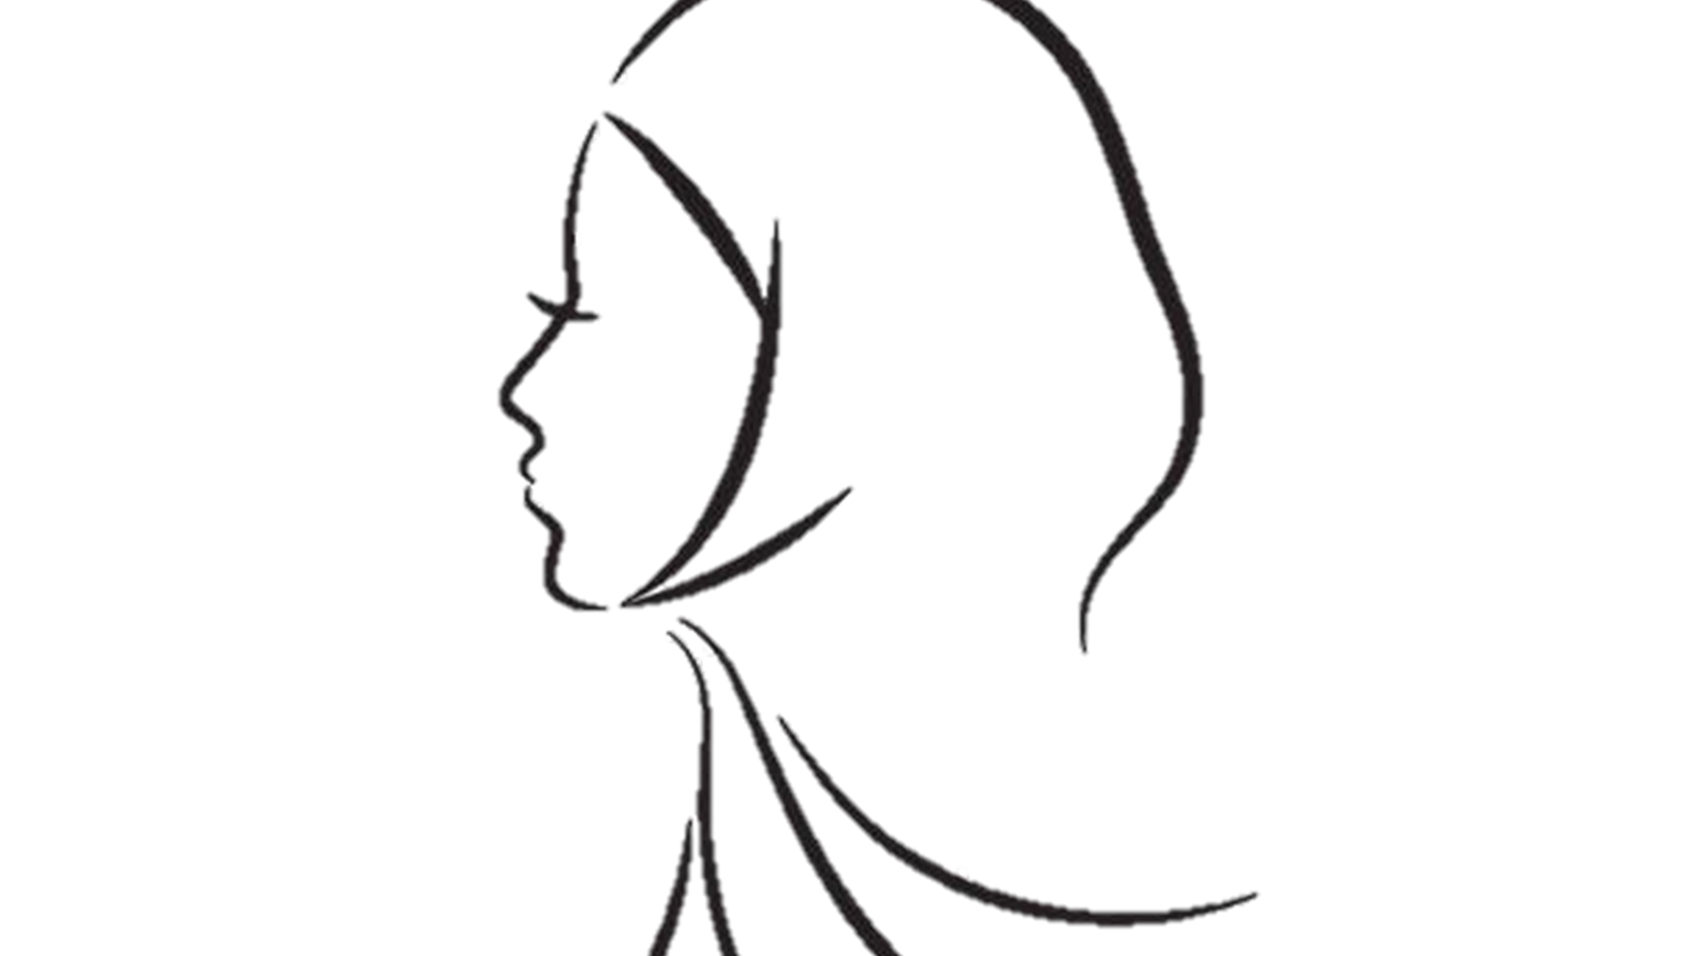
Modesty

Slide 3
Modesty an Attribute (Characteristic)
of Allah the Almighty
“The Holy Prophet ^{sa} said that Allah is Most Modest, Most Noble and Most Generous, in that when a human raises his two hands in prayer, it is contrary (against) Allah’s Modesty (shyness) to turn them away unanswered”
(Friday Sermon 25th April 2003)
(Tirmidhi)

Slide 4
The Holy Prophet ^{sa} The most modest man
The Holy Prophet Muhammad^{sa} was exceptionally endowed with this unique quality of modesty since childhood and God Himself safeguarded this quality of his nature.
God’s Attribute of modesty was present in its highest form in the Holy Prophet’s^{sa} nature. In the Holy Qur’an this quality of his nature has been described as a pure moral value.
Hazrat Sahl bin Sa‘d^{ra} reports that:
The Holy Prophet^{sa} was very modest. Whenever anyone asked for something, he would never disappoint him.
(Muhammad^{sa} The Perfect Man)

Slide 5
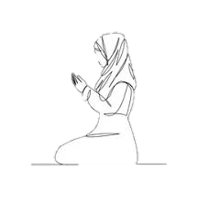
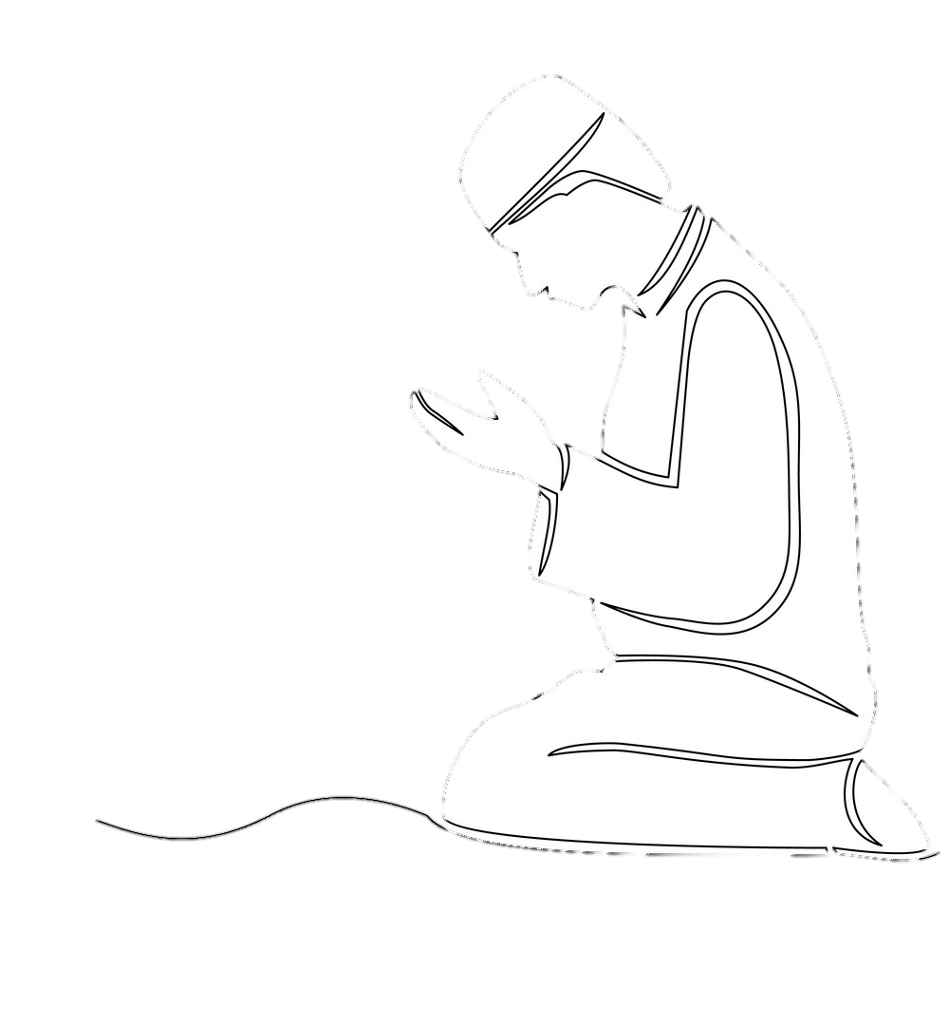
Modesty (for men and women)
The Holy Qur’an makes it clear to instruct men first regarding modesty and then to women. Islam requires modesty both for men and women in acts as well as the way they dress with arms and legs covered. Clothes should be loose enough to not show the curves of the body especially in public.
“Say to the believing men that they restrain their eyes and guard their private parts. That is purer for them”.
(chapter 24 verse 31)
“And say to the believing women that they restrain their eyes and guard their private parts, and that they disclose not their natural and artificial beauty”.
(chapter 24 verse 32)

Slide 6
Modesty for MEN
Hazrat Khalifatul Masih V (aba)
It is also obligatory on men to safeguard their piety and modesty. They have been commanded to observe ghade basr (lowering of eyes) and should keep their gaze lowered and hearts and mind safeguarded against impure thoughts and bad intentions.
(Khuddam/Atfal Ijtema 10th Oct 2017 )
Huzoor e Aqdas (aba) further explains how men are also required to be modest:
If women are not allowed to swim with men then men are also not allowed to swim with women. Thus these restrictions are not only for women they are for men also. The commandments which require men to lower their eyes in front of women has increased the respect of the women. Thus every commandment of Islam is full of wisdom and reduces the possibilities of evils.
(Friday Sermon 13th January 2017)

Slide 7
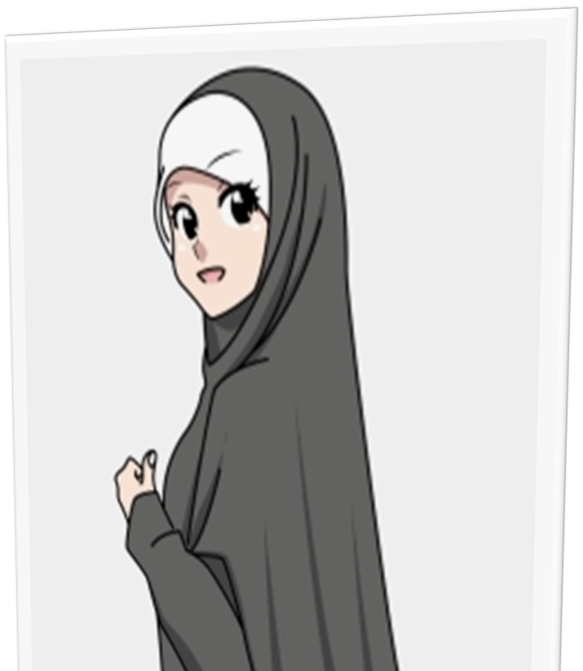
Modesty for Women
Hazrat Khalifatul Masih V (aba) states:
“It is often alleged that Purdah takes away women’s rights. However, we know that this is not the case and the truth is that Purdah and Hijab actually establish the true dignity, independence and freedom of women. Hijab does not only give women physical security but is also a key means of giving them spiritual security and purity of heart.”
(Lajna Imaillah Ijtema UK)
27.10.14

Slide 8
What is Modesty?
Modesty is to do good things and to avoid bad acts. It’s one of the most important morals in Islam.
The Holy Prophet^{sa} used to say that:
“Immodesty found in anything, makes it ugly and
modesty present in anything, makes it beautiful”.
It is a lifestyle. It’s in the way we act with people. It’s in our attitude, in our dressing, our behaviour, our interests, in what we say and what we hear.

Slide 9
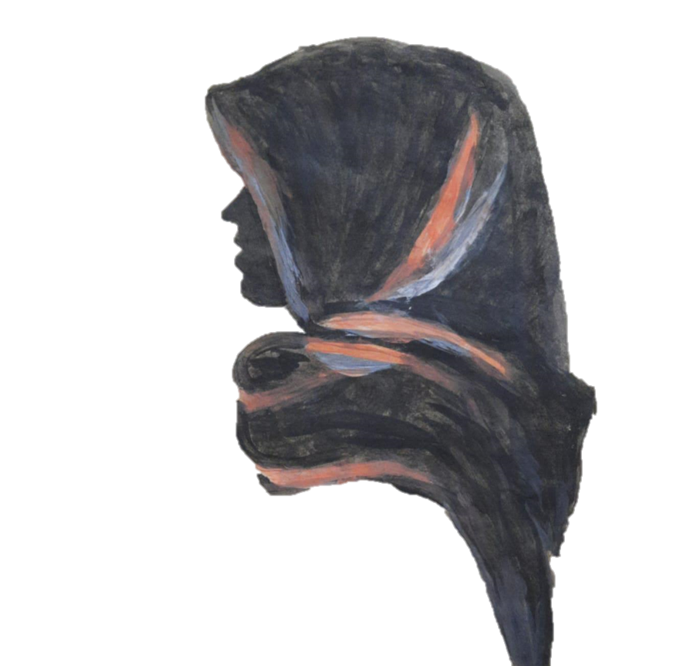
Story from the Holy Qur’an
Purdah and modesty has existed in all past religions which came from Allah. He finally completed His religion and called it Islam. Islam gave clear instructions for mankind to follow for all time.
We have an example in the Holy Qur’an about modesty. During Hazrat Musa’s (as) time two women stood to one side with their animals at the watering place, not wishing to move forward out of modesty. This was because men were gathered with their animals.
It wasn’t that the men were being inconsiderate, the women themselves felt shy and to wait until the men had finished. However, at this instance, Hazrat Musa (as) was observing this scene and felt he should offer his help.
The women were very grateful and went home to tell their father about this very kind, extraordinary man. This man was later to become a prophet.
(Chapter 28 verse 24)

Slide 10
Hazrat Abdu’llah bin Masood^{ra} relates:
The Holy Prophet Muhammad^{sa} said,
"Just to praise Allah is not modesty. Real modesty is to completely protect your heads and all other organs that is: eyes, ears and the belly.

Slide 11
Being modest in what we watch
Television has become a part of our lives and through this medium we are also exposed to good and the bad. For example, inappropriate films, programmes containing bad language etc. If we expose our eyes and ears to such things, it will have an affect on our behaviour.

Slide 12
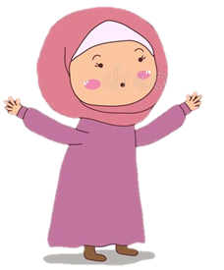
Modesty in Speech
Insults, Sarcasm, Gossip, Arguments – Our tongue has a lot of power! It can either destroy a person or grant them love and peace just by switching words.
The Holy Prophet^{sa} said:
“A word of goodness is an act of charity”
(Bukhari)
Think of words that create friendship and love
for people who might have been unkind to us.

Slide 13
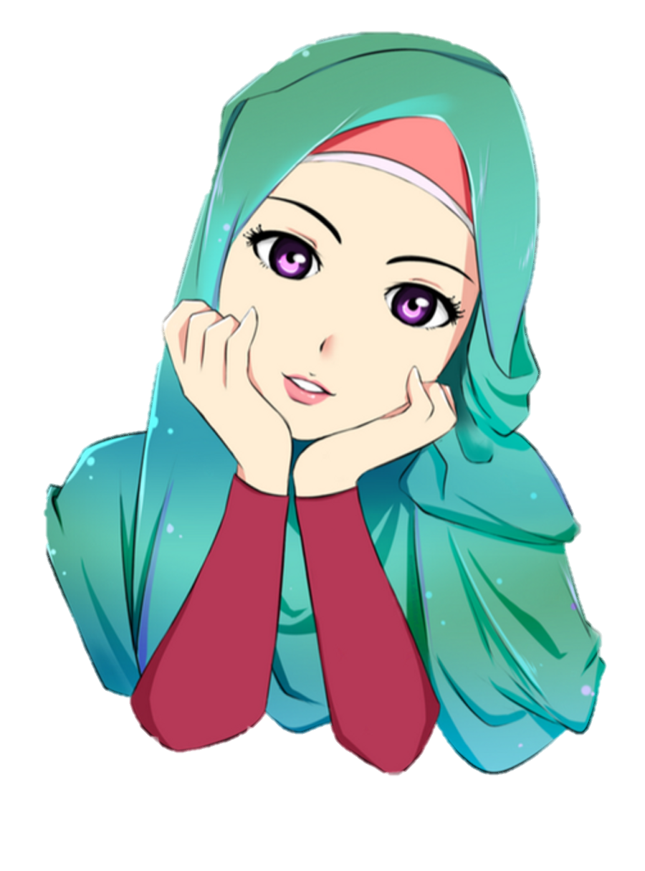
Modesty In Behaviour
Courtesy and good behaviour are a very important part of the Islamic way of life.
The Holy Qur’an says:
“Whatever good you do, Allah will recognize its value.” (2:198)
The essence of good conduct is in moderation, in balance, in boundaries, in patience and in forgiveness.
The Holy Prophet^{sa} said,
“Nothing is heavier in the scales (of Allah) than the
excellence of conduct”
(Abu-Dawood)
Balance & boundaries
moderation
forgiveness
patience

Slide 14
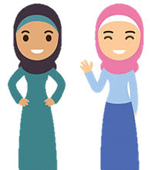
Modesty in Friendship
Hazrat Khalifatul Masih V (aba) said:
In your friendships you should be mindful to not befriend people who take you away from your religion, instead you should befriend those who are decent and sincere rather than those who are immodest and shameless.
(Address at Waqf-e-Nau Ijtema 28th Feb 2015)

Slide 15
Modesty on Social Media
Huzur-e-Anwar has repeatedly drawn attention to using innovation in communication to strengthen our relationship with religion so that we may gain benefit from the educational and spiritual treasures. These worldly resources are bringing precious souls to the right path leading to Islam. In the current era, media has brought us closer to each other not just within a country but around the world.
Simultaneously, irresponsible use of the latest inventions and modes of communications has resulted in extreme moral corruption in every society in this world. Sadly, the misuse of the Internet and Social Media is becoming increasingly common, and this includes inappropriate chatting between boys and girls online, posting pictures, watch indecent and immoral films.
(Social Media by Hazrat Mirza Masroor Ahmad (aba))

Slide 16
Hazrat Khalifatul Masih V (aba) said,
“As I had mentioned earlier, the latest inventions such as TV and Internet have redefined the historically established standards of modesty. Even after showing blatant immodesty, they say it is not so. The standard of modesty of an Ahmadi is not how it is shown on TV and the internet. This is not modesty”
(Social Media by Hazrat Mirza Masroor Ahmad (aba))

Slide 17
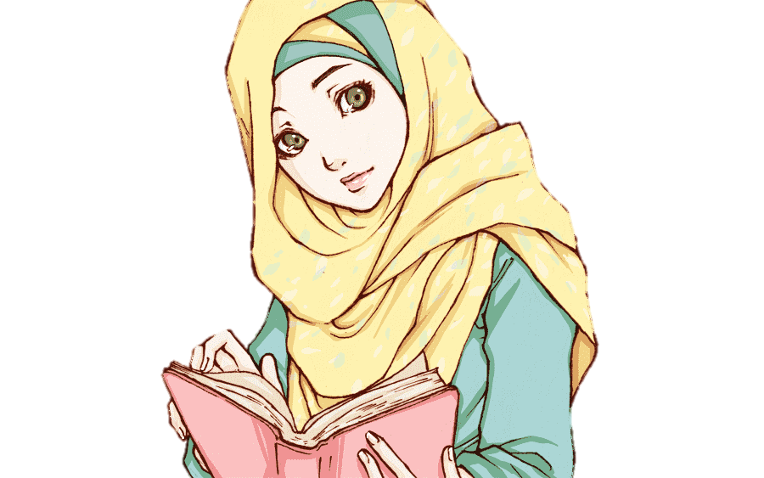
In short, being modest is more than just the way you dress. Take some time to think about how you present yourself in real life and on social media. How you speak, the type of people you befriend or hang out with, how you act in your relationship at home or outside and on social media.
Search yourself to see where you can improve from any of these areas and write them down.

Slide 18
Is it possible to use Social Media with modesty?
Tell us how?
What advice would you give to the younger girls on how to use Social Media …
Make a list of ten benefits related to using Social Media in a modest way.

Slide 19
Notes for Secretaries

Slide 20
Slide 3 note
To explain types of shyness. With Allah it’s not about physical shyness, it’s about feeling shy to turn someone away when they come to Him for help. The same principle applies to us. We should also not turn anyone away when they come to us for help.
Slide 7 note
Discuss in which ways does hijab give us dignity, independence and freedom.
Slide 8 note
Discuss all the underlined words.
Slide 10 note
Discuss: How head, eyes, ears, and belly is applicable here. Head: to keep pure thoughts, eyes: to see, view good things e.g: positives of social media, TV content etc, ears eg: to protect them from listening anything bad about someone or on social media etc, belly: to keep it healthy with good food as it affects our behaviour.
These discussions can also be carried out as individual topics in Nasirat classes.
Slide 11 note
Discuss their choice of programmes in what they like to watch. How their choices might affect them, some being positive/ negative
Slide 13 note
Discuss the words in the speech bubbles.
Slide 14 note
Ask girls what they think this means. Do they understand how good or bad friends effect us?.
Slide 15 note
How many platforms does Jamaat use on social media? What Jamaat programmes do you watch on social media?
Slide 16 note
Have you ever helped someone on social media who was being bullied? Can you share negative and positive experience of social media?

Slide 21
*Secretaries should be mindful of the age of Nasirat for certain discussions. E.g. Social media. A ten year old may not understand fully or in as much detail as compared to a 14 year old. So please tailor your discussions to the age of your Nasirat.
*You can also use slides from this presentation for your discussion corners and question/answer sessions
Discussions can also be carried out as individual topics in Nasirat classes. These can be included in your reports.

