Slide 1
Cyberbullying
Think before you click

Slide 2
In what ways do you think cyberbullying happens?
Receiving nasty or inappropriate emails.
Nasty comments on social media.
Someone deliberately posts a nasty or embarrassing picture of you on social media without your permission.
Prank phone calls.
Getting nasty or inappropriate text messages.

Slide 3
What Could You Do If You Or Someone You Know Is Being Bullied?
Tell an adult you trust, e.g., a parent, teacher or an adult member of your family.
1
Never respond to any form of cyberbullying.
2
Use the 'Report It' button to report a problem to the social networking site.
3
Show whatever you receive to a responsible adult, so that they can help you.
4
Don't keep it to yourself! People want to help you and make it better.
5

Slide 4
Look at these scenarios
Can you come up with a solution to the problem?

Slide 5
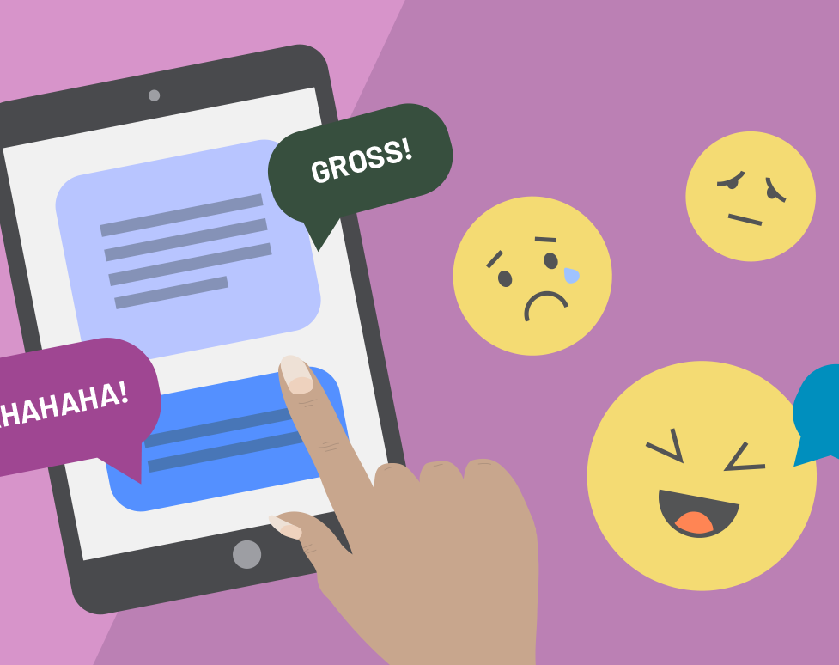
Scenario 1
Teenager Julianne was bullied in school by a group of girls in her class. She thought of her bedroom as a refuge from the bullies, until they started taunting her online. The girls found her profile on a social networking site and began posting hurtful messages. They called her names and threatened her. Later, they found out what her phone number was and started talking to her. Julianne thought it was one of her friends, until they started calling her names. They told her that they were going to hurt her at school the next day. Julianne was frightened.

Slide 6
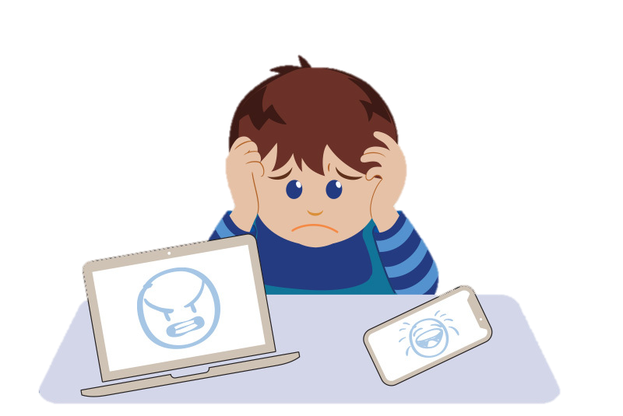
Scenario 2
Salim is 14 and a Pakistani Muslim. He has recently started to receive e-mails containing racist threats. He is very worried and hurt by their content. What advice would you give Salim?

Slide 7
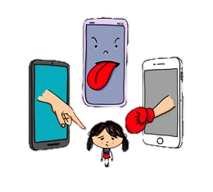
Scenario 3
Your sister Ayesha is terribly upset because she has found out that someone in her group of friends at school has disclosed her mobile telephone number. She now regularly receives prank and malicious calls.

Slide 8
Reflection
What have you learned today that will help you to keep safe from cyberbullying?
Do you think you would know what to do and who to talk to if you, or someone you know is being bullied in any way?

Slide 9
JazakAllah

