Slide 1
Online Gaming Safety Quiz

Slide 2
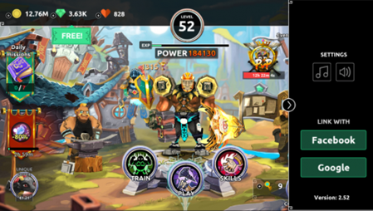
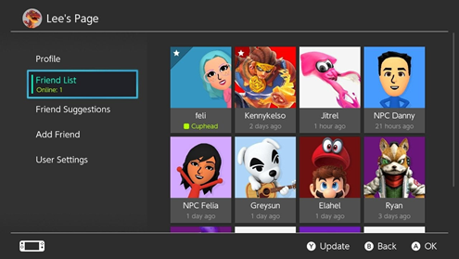
Your internet gaming account is private and you have fewer friends online than lots of people in your class. What do you do? (choose one option)
You don't add anyone you don’t know in person. You know who your true friends are and that’s what matters.
Ask your friends to recommend people that you could add. At least you'll know they're trustworthy.
Start to accept friend requests from anyone so you can get more friends as quickly as you can.

Slide 3
Answer
. You don't add anyone you don’t know in person. You know who your true friends are and that’s what matters.

Slide 4
When playing online Games, what information should you not post online?
Personal Details
What you’ve had for dinner
A Picture of your favourite Gaming Character
Which school you go to

Slide 5
Answer
Which School you go to
& Personal Details

Slide 6
Someone from another school, that you know online, wants to meet you outside the local shops, so you can hang out together. You know their name but haven’t met them before. What should you do?
Meet
Meet them outside the shops; it’s a busy place so you’ll feel safe by yourself.
Let
Let your parents / carers know straight away.
Tell
Tell them you’ll be there after school, and make sure your friends come with you.

Slide 7
Answer
Let your parents / carers know straight away and refuse to meet them.

Slide 8
You are playing a Game and meet someone online who tells you they are the same age as you. So it is safe to share personal information. They keep asking you to share this information. What should you do?
Tell them as much as they tell you because that is fair
1
Make up fake information so they stop asking you
2
Not share any Personal information
3
Tell them where you live so you can meet up as it is safer
4

Slide 9
Answer
Not share any Personal information

Slide 10
Your best friend tells you their password and says, ‘If you’re a good friend then you’d share yours too.’ What do you do?
Say that you can’t share your password because it’s just for you.
1
Make up a password and tell it to him/her, to keep them happy.
2
Share your password, they’re a good friend and you trust them.
3

Slide 11
Answer
Say that you can’t share your password because it’s just for you.

Slide 12
You are playing an online game and someone you don’t know wants to add you as a friend. What do you do?
Add
Add them, it’s nice to have more friends. Add them, it’s nice to have more friends.
Let
Let your parents or carers know, so they can check who it is.
Ask
Ask the unknown person a few questions first to get to know them.

Slide 13
Answer
Let your parents or carers know, so they can check who it is.

Slide 14
The latest online game involves video calling surprising your friends and trying to scare them as much as possible, then posting the video for everyone to see. A lot of your friends have done it and now say it’s your turn. How do you feel?
You eventually choose to take part and decide to apologise later.
B. You do it without hesitation. You don’t want to be the only one who’s left out!
C. You decide not to take part

Slide 15
Answer
You decide not to take part

Slide 16
Your Friends introduces you to an online friend she has been playing with and wants you to meet up with them and play together in their home. What should you do?
Yes
Say Yes if your friend is also there
Yes, and Meet
Say Yes and Meet them
Yes, and double-check
Say Yes and double-check with your Parents
Tell
Tell them you are sorry, but you can’t meet them as you don’t know them

Slide 17
Answer
Tell them you are sorry but you can’t meet them as you don’t know them

Slide 18
What is the Best way to find a Safe Game?
Ask your friends what Games they play
01
Search for games on trusted Websites
02
Look for games that need to be downloaded
03

Slide 19
Answer
Search for games on trusted Websites

Slide 20
JazakAllah
Nasiratul Ahmadiyya UK

