Slide 1
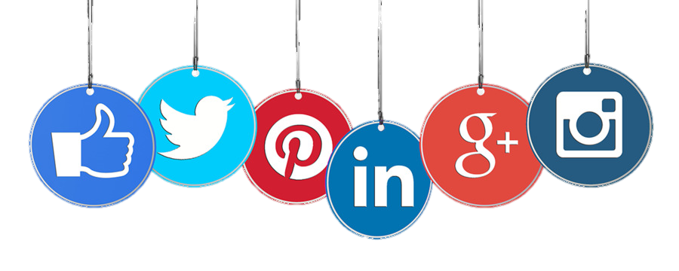
Online Modesty & Social Media

Slide 2
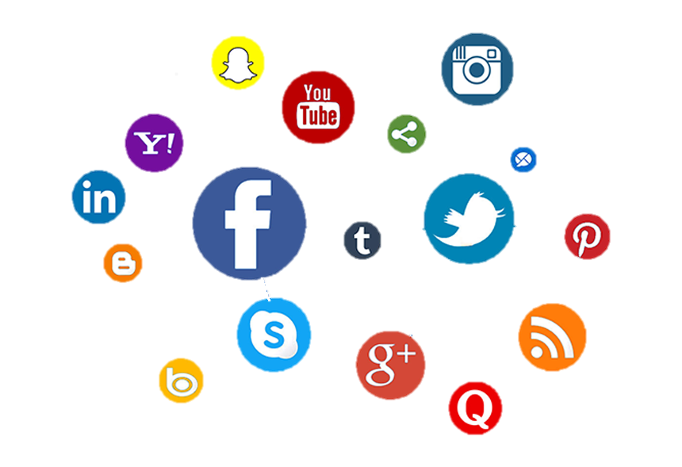
What is “Social Media”?
“Websites and applications that enable users to create and share content or to participate in social networking.”
A way of staying in touch and communicating with friends and family
Social Media is unique in the sense of being broad
and uncensored.
Compared to other means of mass communication like newspapers, radio stations, television channels, there are far fewer limitations of what someone can share.
Anyone with Internet access can sign up for a social media account, they can then share whatever content they wish to, and this content can reach anyone that visits their page or profile.
Notes:
Reference for sentence in quotation marks?

Slide 3
Way to connect and share content with friends and family
Online video platform
Popular photo sharing app
What apps are available?
Exchanging pictures and videos for short amount of time before they disappear
Microblogging and social networking
Professional networking
Discovering and saving images
Messaging and calling app
Short form of sharing videos

Slide 4
Benefits of Social Media
Social Media is a platform whose benefits and downsides are reflected by the individual user.
A key benefit derived from such platforms is the development of social skills.
People who find it hard to talk to others and express themselves, can do so through a shielded and protected way.
Therefore, making them well-spoken and more confident.

Slide 5
Another vital benefit of Social Media is the knowledge of current affairs; it helps you access through safe and easy to use platforms.
An example of this would be the news about the advances of science etc.
The ability to learn and share opinions on world events gives you a sense of importance and a voice.
This then helps people develop real-life skills and give them a clear and insightful perspective on the world, and lets you share yours.
Benefits of Social Media

Slide 6
What is online modesty?
Online modesty is to make sure that you are not becoming a target for the opposite sex; to approach you or look at you with a harmful gaze.
It is similar to wearing a hijab where your beauty is not displayed for anyone to gain access to it via a screen.
The things you watch, like, post and comment should also be modest and be decent. Your actions online are a reflection of your character.
The internet is developing very quickly and your pictures and videos can be accessed by many.

Slide 7
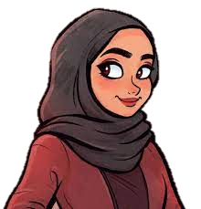
How can we be modest online?
Make sure that we are not showing/posting pictures and videos of ourselves or of parts of our body parts including hands. This will train you for what you should or shouldn’t share online
Avoid entering into a discussion with the opposite sex online as this does not come under purdah (you would not randomly start speaking to a man whilst you are outside so the same applies online)

Slide 8
How can we be modest online?
Ensure that your parents know who you are speaking to when you are online and try to limit your social media usage
Not leaving hateful comments on social media including foul language as this is rude and is not pleasant to read
Thinking twice before posting something on the internet as this is hard to take down once it is online

Slide 9
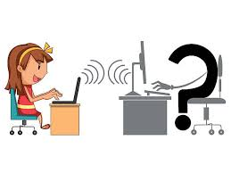
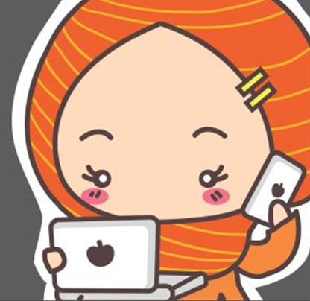
Possible Risks &
Dangers of
Social Media
Social media has certain advantages, but it also possesses some risks if we are not careful, responsible and modest.
There is a huge variety of limitless content, and we can also get exposed to inappropriate content that is mean, aggressive and violent content which can make us upset and as a result leads to stress and psychological problems.
We sometimes also share funny and embarrassing pictures of our friends which results in rude comments from different people. This eventually effects our mental health and friendships.

Slide 10
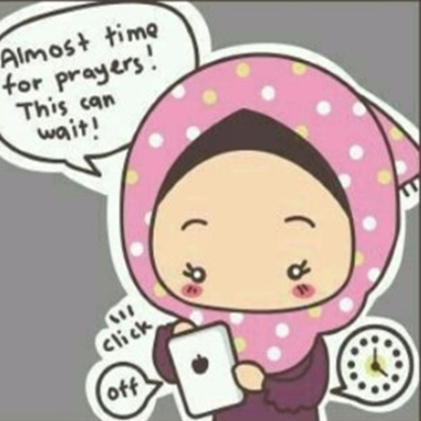
Possible Risks & dangers of
Social Media
Moreover, young people download games from internet and to start playing those games, the app asks personal details like name, gender, age, address etc.
The younger generation also sometimes share personal information like pictures, date of birth, phone numbers with strangers as at the start they do not realise the consequences, but this leads to cyberbullying.
Furthermore, this addiction also becomes a factor of obstructing with the academic performance of a student as they waste their time on social media instead of studying.

Slide 11
Oversharing on social media makes children a target for predators and hackers. Young girls and boys also make friends online and this is risky as well as they have no clue who they are talking with and what is the real identity of that person.
Recent research shows that 1-in-4 Teens have been the victim of cyberbullying via social and a half (50%) of teens have witnessed cyberbullying. These are astonishing figures!
On Snapchat, it says that the picture disappears after 24hrs, however, that is not the case. The pictures and videos disappear from the phone, but it does not disappear from the main database of that app. This thus shows that if a picture is sent to someone, it does not go anywhere even after 24hrs.
Similarly, Instagram is promoting false beauty standards for example in terms of beauty filters. In a survey of 227 female university students, women reported that they tend to compare their own appearance negatively with their peer group and with celebrities, while browsing Facebook and Instagram.
Furthermore, on WhatsApp they have introduced a feature of the disappearing of messages as well, but it is disappearing from your own device, not from the app. So, these are the possible risks of social media if we are not modest.
This is thus creating stereotypes that women have fought for a long time like false beauty standards.
Notes:
Reference for the recent research?

Slide 12
How to deal with these issues?
It is important that we do not accept random friend requests of strangers and people we don’t know.
Be cautious and careful of what you spread and share. Remember to check the authenticity of the source and app you are using.
Also, avoid posting pictures publicly as it can lead to cyberbullying.
It is also extremely important that we set a strong password for the account.
So, to avoid these issues, we should have enough knowledge of the social media apps we are using and should know what the age restriction are.
Furthermore, we need to make sure and keep any personal profiles private so strangers cannot invade your privacy i.e. photos, date of birth and location.
Notes:
The part highlighted in Yellow - two different points

Slide 13
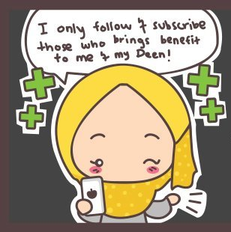
Remember to use technology to do good. Set a trend of goodness which in returns helps you and your family and friends.
How to deal with these issues?
Make sure to delete or remove those apps or sources who do not bring benefit to you.
Be careful of what and who you follow and subscribe to. Remember to follow Jamaat pages and apps for reliable information
(Nasirat Instagram page).

Slide 14
How is Social Media beneficial for us?
As Nasirat, social media gives us an approachable way of learning more about our jammat.
A few examples of this include the official Ahmadi Instagram accounts (a private account available for Nasirat), twitter pages and various YouTube channels.
Accounts like the Instagram page and twitter can give us a sense of community amongst the jama’at.
Also, allowing the opportunity to create and build friendships with other young girls.

Slide 15
How is Social Media beneficial for us?
Our jama’at has a variety of YouTube channels, the focus of these channels is to provide an easy way to watch MTA and other insightful programs.
This can be very beneficial as it allows us to view programs we may have missed.
Moreover, having access to these shows can broaden our understanding of Ahmadiyyat and grow our spiritual well-being.

Slide 16
How can YOU raise your voice for Islam?
There are many incidents happening around the world which are targeting Muslim women, as a young Ahmadi Muslim girl you are allowed to raise your voice. However, there are a few things you should note before doing this…

Slide 17
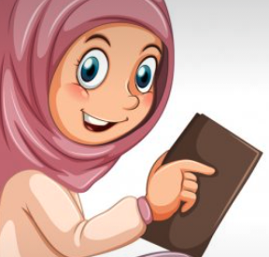
How can YOU raise your voice for Islam?
You should not have photos of yourself on your blog/social media profile (If you have an account already).
Do not engage in an argument with anyone online but relay your message in a calm manner, preferably without the comments section active.
Please check with your Nasirat secretary if you would like someone to double check the facts are accurate in your post.

