Slide 1
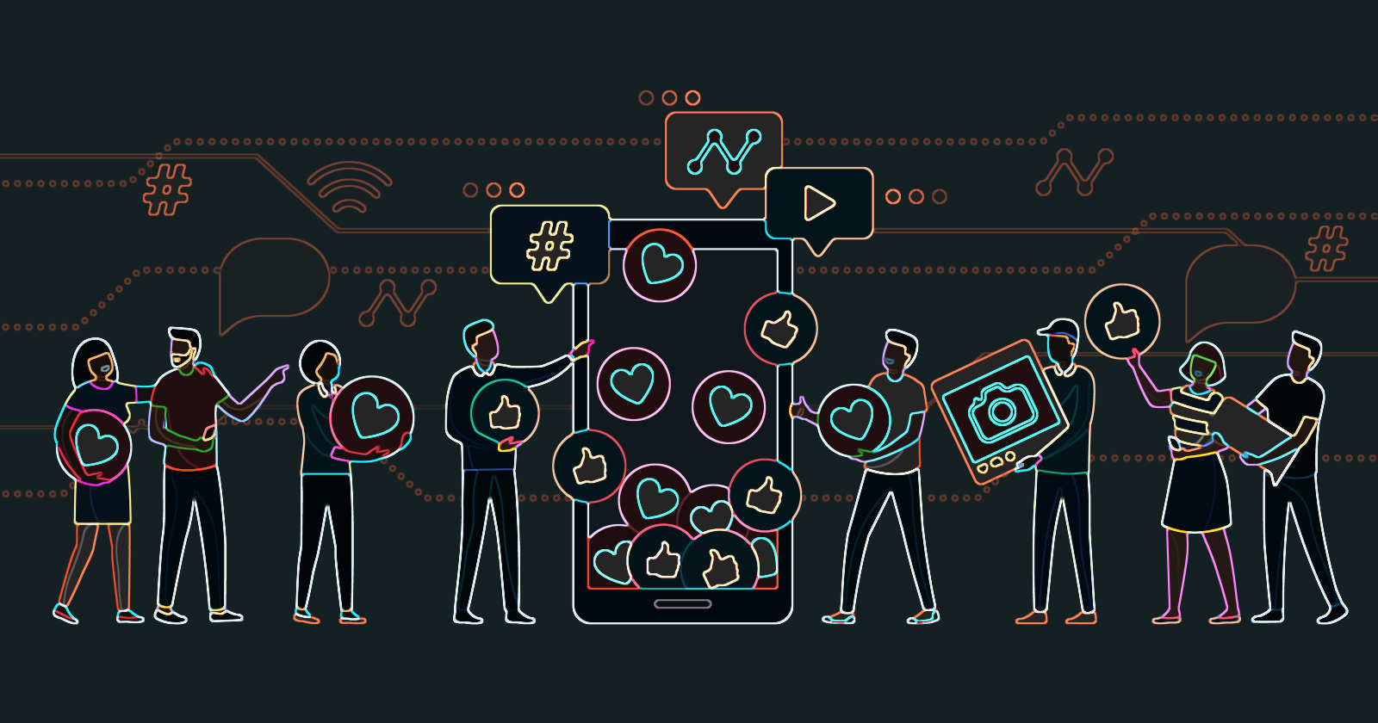
Online Virtues
Online Behaviour reflection
How can we make a habit of doing what is good and right online?

Slide 2
PRUDENCE
NOW THINK FOR YOURSELF
Do I show prudence in making the wisest choice in what I post, text or share online?
Do I think before I make a comment?
YES
NO
SOMETIMES
WHAT IS IT?
Making judgements of fact to see what is right and wise rather than what is easier. Skill of weighing facts to make a good judgement.

Slide 3
JUSTICE
NOW THINK FOR YOURSELF
Do I say/post/share/comment what is morally right?
Do I stop myself from posing something that I shouldn’t or may regret later?
YES
NO
SOMETIMES
WHAT IS IT?
Seeking to do what is right, fair and good. Doing what is honouring and morally right.
We should always try to bring about what is right and not do anything wrong just as we wouldn’t in real life. We should stand up for others’ rights

Slide 4
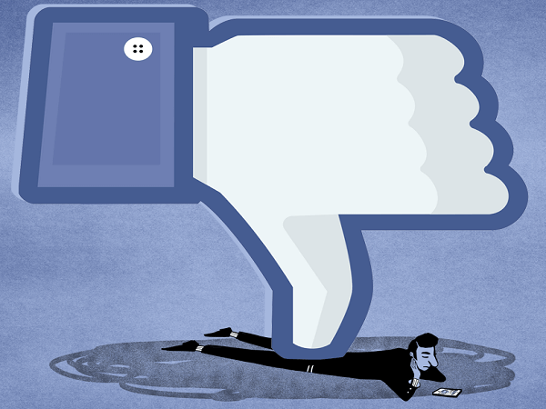
FORTITUDE
NOW THINK FOR YOURSELF
Have I even been involved in a conversation or content which made me feel uncomfortable, scared, confused or threatened?
Who can I go to when I need to talk or need help?
YES
NO
SOMETIMES
WHAT IS IT?
Strength to resist temptation, doing what is right with courage and patience. It is a strength of mind which allows a person to encounter danger or bear pain or adversity with courage.

Slide 5
FAITH
NOW THINK FOR YOURSELF
Do I share my faith online?
Am I able to stand out as a Muslim and preach my religion confidently?
YES
NO
SOMETIMES
WHAT IS IT?
Belief in God and his prophet and everything he has revealed to us.
While using social media we have the power to alter people’s opinions and thoughts on different aspects, so we should try to preach our religion and share a positive message to everyone looking at our posts and comments.

Slide 6
TEMPERENCE
NOW THINK FOR YOURSELF
Do I moderate my time on social media?
Do I create a healthy balance of real social time vs virtual social media time?
YES
NO
SOMETIMES
WHAT IS IT?
Learning to bring about balance and moderation in your life. You should take the middle road, avoiding extremes and use things for good. Often young people become addicted, and this has a severe impact on peoples’ health and academic performance as they spend too much time on social media.

Slide 7
HOPE
NOW THINK FOR YOURSELF
Do I trust in God and prayer to guide me in my decision online?
Do I ask God for help when I think I have done something wrong?
YES
NO
SOMETIMES
WHAT IS IT?
Trusting in God and always hoping for the best. There is a large variety of content on social media, and we can also get exposed to inappropriate content which can make us upset and as a result leads to stress and psychological problems. In this situation we should put full faith in God and trusting him to guide you to do what is right.

Slide 8
JAZAKAMULLAH

