Slide 1
SOCIAL MEDIA TO DARK WEB

Slide 2
Let’s take a Selfie…

Slide 3
After Uploading On Social Media

Slide 4
But the truth is…
Posting and sharing photos online seems harmless, but you could be inadvertently leaking sensitive business and personal information, according to experts.
Virtually all smartphones can track you through what is known as geotagging, adding location data from satellites. If you leave your phone’s location services on, this information is added to your photos by default. The tag stays with the picture even after it’s shared online, allowing you to be tracked.

Slide 5
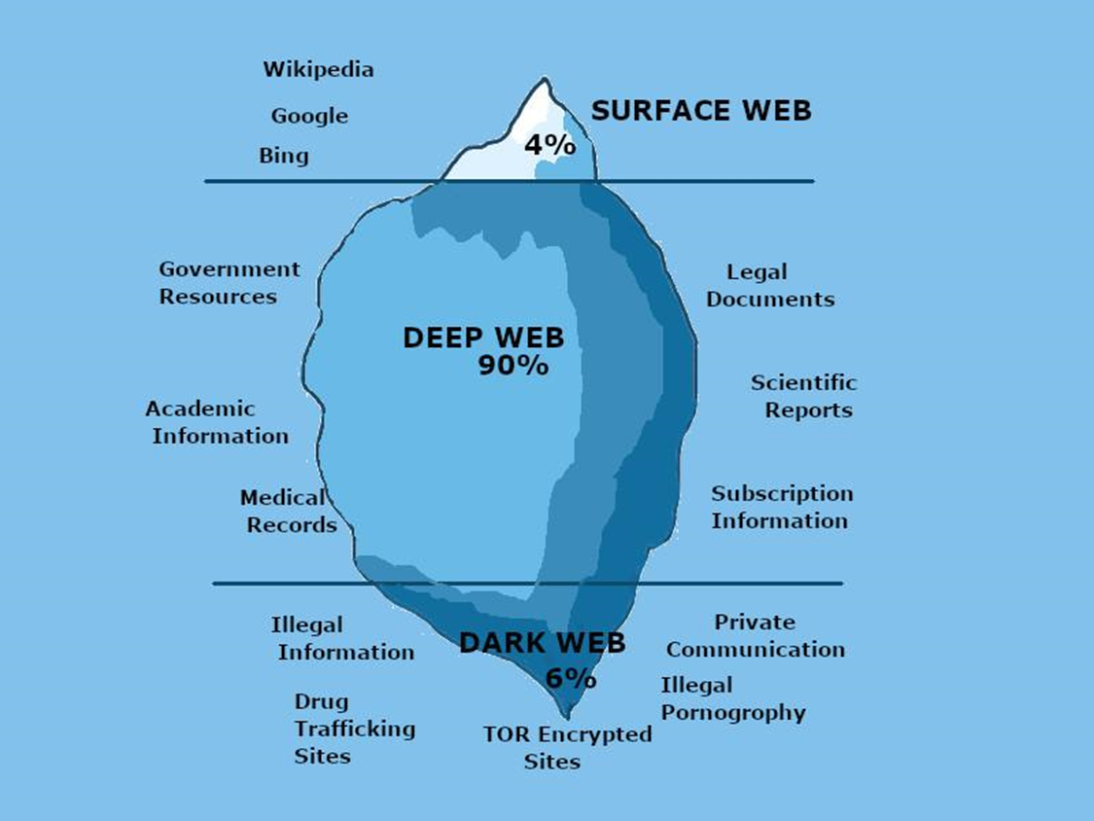
Your Pictures Can End Up On Dark Web

Slide 6
Guidelines for Nasirat
Increasing mutual connections, exchange of pictures and comments, creates an open door for attack to our moral values. Therefore these should be absolutely avoided by Ahmadis, whether they're men, women or our youth.
Huzur-e-Anwar (aba) warned regarding this important issue: “These days a new method of introduction has been created on the computer and the Internet called Facebook. Though it is not that new, but it was introduced in the last few years. I had previously discouraged you from this practice. I had said in my sermons that it encourages immodesty. It shatters the boundaries among people, boundaries from one another, boundaries around secrets. It exposes secrets and invites indecency. The creator of this site has said, ‘I have created this and I believe that whatever a man is on the outside and inside should be exposed to others.’ In his view, exposing someone means that if someone wants to post a nude picture of himself, he may and even encourages others to comment on it. This is allowed! Innalillah [“To Allah we return”]. Similarly, anyone can post about anything he sees. If this is not extreme moral regression and degradation, then what is? In this state of moral regression and degradation, an Ahmadi has to teach the high standard of morality and virtue.”
(Concluding Address Jalsa Salana Germany 26 June 2011)

