Slide 1
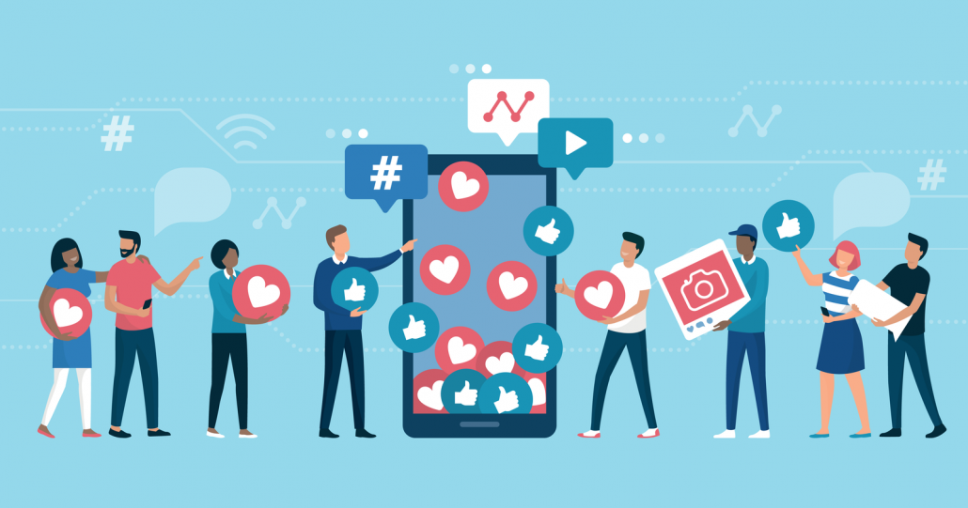
Social Media ETIQUETTES
Nasirat ul Ahmadiyya UK

Slide 2
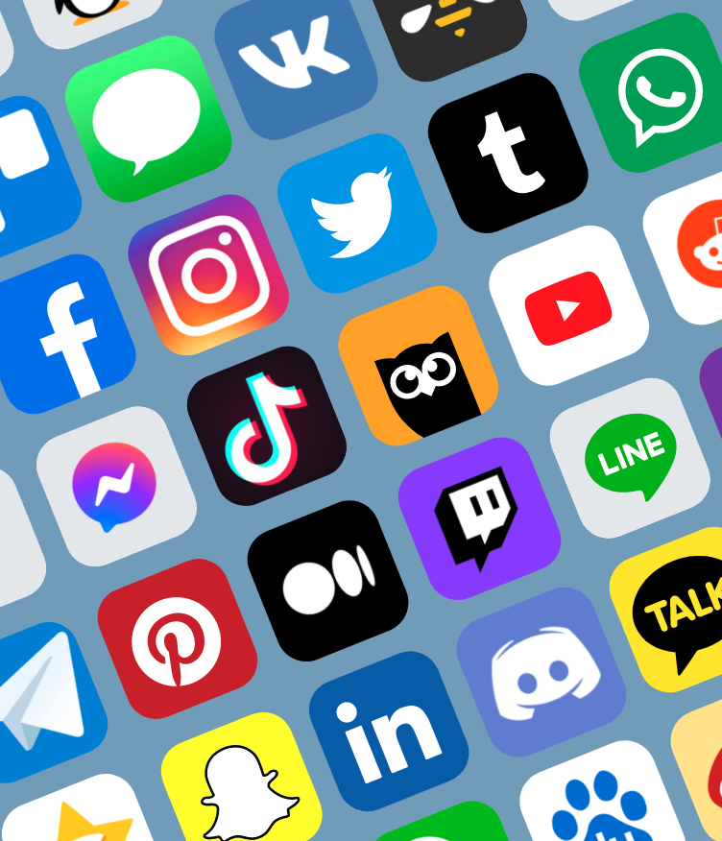
What are social media etiquettes
The definition of etiquettes is “the customary code of polite behaviour in society or among members of a particular profession or group” some synonyms for this would be proper behaviour, manners, rules.
Social media etiquettes dictate how you should act on social media platforms. The demands of social media etiquettes differ from one platform to the other. For example, reposting someone’s content on Instagram requires much more care and effort than retweeting someone’s on Twitter.

Slide 3
What are social media etiquettes
Be respectful - If you wouldn’t say it to someone’s face, the internet is not the place to say it either.
Be aware of how your comments might be read - Think; if you were to receive this comment, how would you have felt?
Be careful with humour and sarcasm - Reread what you have written and think, will everyone get the joke?
Think about who can see what you have shared - Remember you are only as private as your much public friend.

Slide 4
What are social media etiquettes
Remember to check friend requests and group invites before accepting them - If it isn’t from someone you know or recognise then it is ok to decline the request.
Be forgiving - Remember that not everyone will know these rules before posting or realise that they have upset someone else.
Be respectful of other cultures
Be Responsive not Reactive

Slide 5
Why are social media etiquettes important?
What am I sharing?
Questions like this keep you in check and ensure you do not post inappropriate content or sharing too much, the internet never forgets.
Etiquette provides the framework for tackling the “people part.” Without it, you’re flying blind on all those platforms. Never forget that you are communicating with people and you are also representing yourself online therefore, you must be mindful of your presence. Using good etiquette is one way you can help collectively tip the scales back in the direction of people being nicer to each other.

Slide 6
Why are social media etiquettes important?
Why are You on Social Media?
It is important to have a clear goal of why you operate an account on chosen social platforms. Accumulating likes or seeking online validation should not be the reason for being on social media. Also, your social media platforms should make you a better individual, by learning and engaging in meaningful conversations
Social media etiquettes make you more empathetic towards others. Using etiquettes on social media encourages you to put yourself in people’s shoes. If someone posts content without giving much thought to it, it can cause some serious damage.
For example, sending out offensive tweets on Twitter or engaging in aggressive online debates can bring embarrassment to the individual and a community overall.

Slide 7
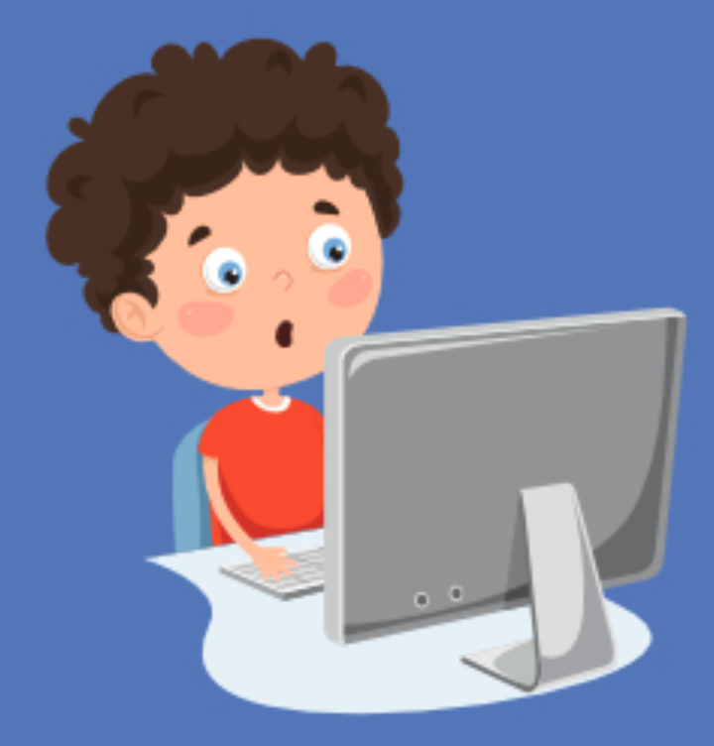
What comes under social media etiquettes?
1. Not over sharing (personal information)
2. Don’t spread rumors or fake information
3. Take care of how you represent yourself as an Ahmadi Muslim
4. Be respectful of differences
5. Be considerate of your choice of words
…Spread positivity online

Slide 8
What comes under social media etiquettes?
Think twice about what you post – e.g. inappropriate memes
Act how you would want to be treated
Leave out name calling
Don’t add people you don't know on your social media accounts
Don’t overshare

Slide 9
What comes under social media etiquettes?
Be your own person!
Never send inappropriate pictures or messages
Don’t message or engage with the opposite sex
Be nice – words on the screen can hurt the same as in real life
Never give out your address or personal details

Slide 10
Islamic teachings of modesty
Islam teaches moderation so social media can be used as long as we are careful and modest
As Ahmadi girls we should have higher values and more respect for ourselves

Slide 11
Do’s and don’ts
Do’s | Don’t’s
Every platform, such as Youtube, has comment sections. If there is something you do not like about a video then there is no need to be mean or support others who are being mean as this comes under cyberbullying. Do post that you do not intend any harm and that if there is, to please let you know so you can take it down or explain intention/s Do use good, modest and positive vocabulary in comments and posts Do try to use platforms like twitter for Tabligh such as posting quotes/sayings of the Holy Quran, hadith, sermons etc Do seek guidance from adults who always have far more experience and better judgement. Ensure that an adult knows what you are doing online to help keep you safe through their guidance | Don’t post things when you are angry. It is better to be calm so that you can think things through before you post to avoid further damage. Don’t share too much personal information online Don’t put other people’s pictures, personal info, or other such things without the other person’s permission online that may offend them and may cause conflicts between you and them Do not put pictures of yourselves on profile pictures because, as you get older, purdah should be given more importance to protect you from any harm and ensures your privacy Do not make a Facebook account according to the instructions of Huzoor Anwar^{aba} Every platform, such as Youtube, has comment sections. If there is something you do not like about a video, then there is no need to be mean or support others who are being mean as this comes under cyberbullying.

Slide 12
Do’s and don’ts
Just because there are a few things you can’t do doesn’t mean you can’t have fun on Social Media. These are a few things you should do instead:
You can post images of hobbies you do (like cooking or gaming), or photos of scenery
You could even post your favourite quote
You can talk to your friends and contact them
You could also find accounts which have similar interest to you and like their posts
Social Media can also keep you up to date with news and things going around in your local community

Slide 13
Social media etiquettes and modesty
Modest vocabularies consisting of kind words with compassion gives out the intention of peace which is the definition of Islam
Treat others like how you would want to be treated is a ‘Golden Principle’ of Islam which should also be applied digitally because it is easy for someone to hide behind a screen and say mean things
Being a good example to others
Islam lays great importance on respecting others. This is why you should be careful with what you do on social media to ensure that your posts and intentions portray respect

Slide 14
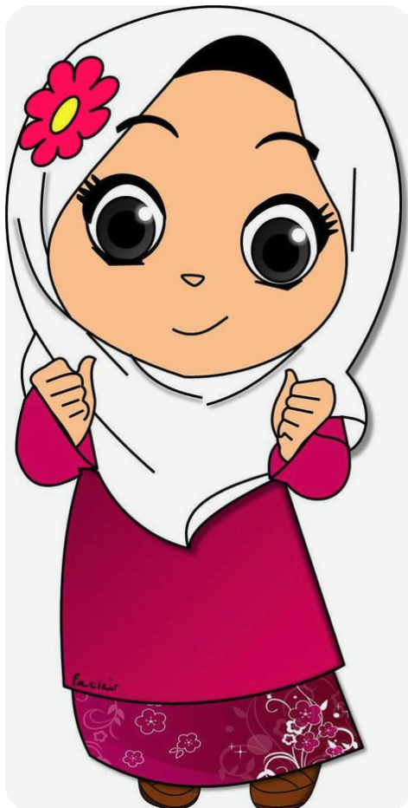
Benefits of being modest on Social media?
You feel positive and stay in a positive state of mind
You feel safe and secure knowing you have not over shared on Social media
Your parents trust you
Your siblings and friends will also follow your actions and you are protecting them also

Slide 15
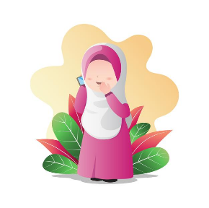
Learning from mistakes
It is easy to get confused between what we can and can’t do, however as Ahmadi girls our goal is to follow the guidance of our Beloved Huzoor the best we can. This year our motto is ‘Modesty is a part of faith’ and we must follow this during each circumstance - including our presence on Social Media.
A mistake which is commonly made is the incorrect use of the profile pic option on Social Media sites such as; WhatsApp, Instagram etc.

Slide 16
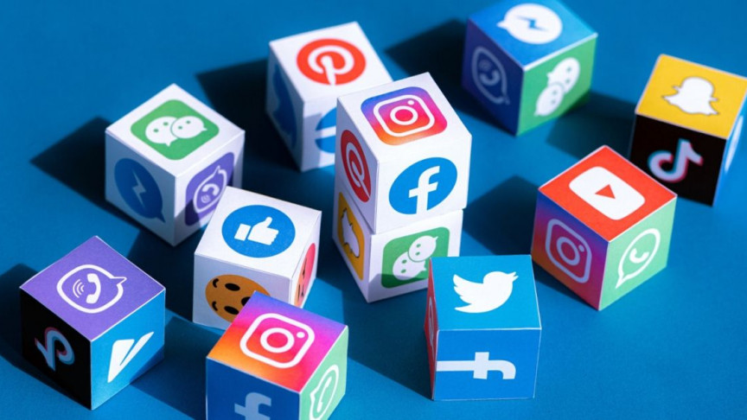
Learning from mistakes
A photo of yourself or a photo featuring your own hands or ears is sometimes used - this is not allowed as your hands or any other body part should not be presented in such a way.
Furthermore, the photo of someone else/ or their hands shouldn’t be used- this spreads misinformation as those who see the photo will think it's you. Most of these guidelines are in place in order to keep you safe and modest, but this does not mean you can't be unique and have an identity online. A scenery, pattern or even a photo of your hobby can be used to show your interests and individuality while staying modest and secure.

Slide 17
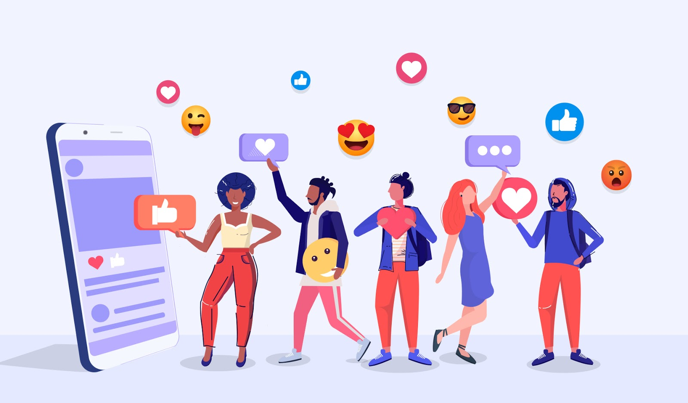
Guidelines
Quotes can be used on display pictures/profile pictures as a source of Tabligh in the digital world. It will also increase your own knowledge in regard to Islam
There are various diverse people out there in the world which can often get complicated. What you believe as part of your culture/values/belief may go against theirs which is why it is important to highlight that these are your views
It is easy to get influenced by social media which is why adults should know what you do online for them to better guide you. It is hard to morally distinguish what is right and wrong on social media which is where parents come in. They are better able to guide you morally according to Islamic principals
It is important to remain attached with the Jamaat and khilafat, so following jamaat pages are a good way to go in increasing your knowledge in terms of jamaat activities and learning new things about the jamaat on all common platforms like twitter, YouTube and Instagram

